Slide 1
ASCII ART SYNTHESIS FROM NATURAL PHOTOGRAPHS
A PRESENTATION BY
ASHWATHY BABU PAUL

Slide 2
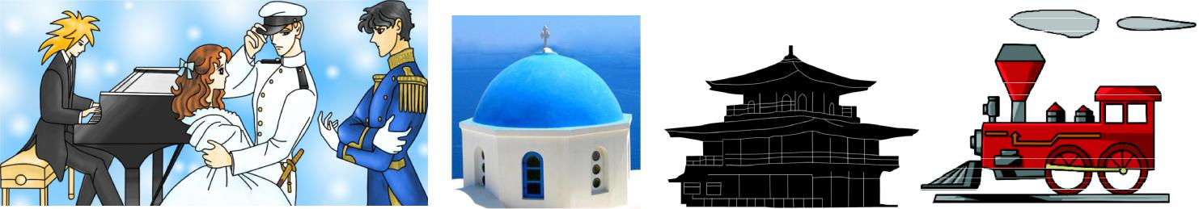
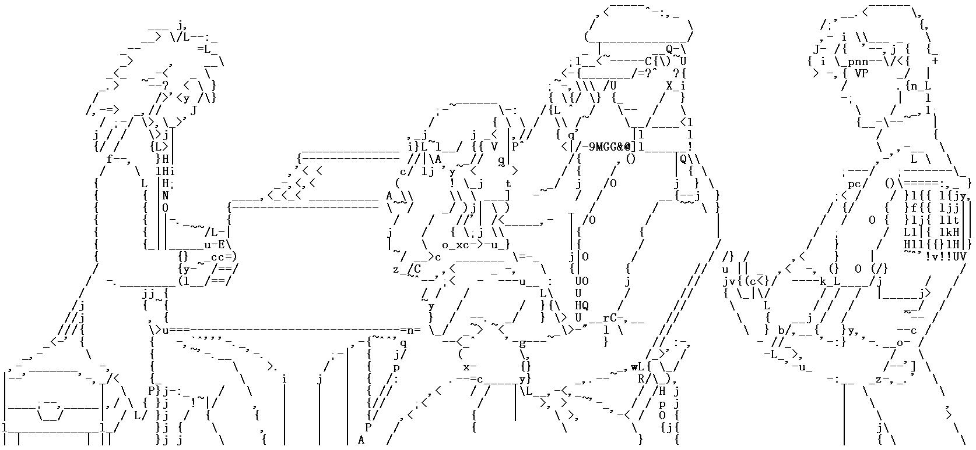

Slide 3
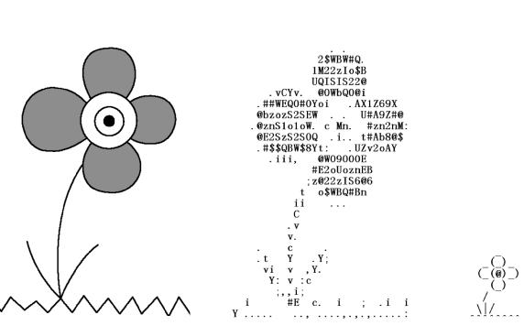
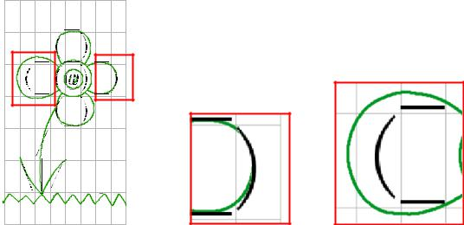

Slide 4
PROBLEM STATEMENT
ASCII art from natural photographs - major challenge.
Extracting the perception-sensitive structure from the natural photographs
Concise ASCII art reproduction based on the structure
Excessive amount of texture in natural photos-extracting perception-sensitive structure not easy

Slide 5
PROBLEM STATEMENT
Tougher when the structure may be weak and within the texture region.
To fit different target text resolutions, the amount extracted structure should also be controllable.

Slide 6
OBJECTIVE
A visual perception mechanism
Which can better separate weak structure from the crowded texture
Can also better control the scale of texture suppression

Slide 7
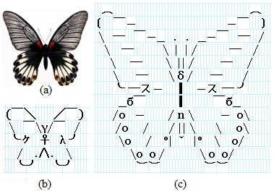
OBJECTIVE

Slide 8
FUNCTIONAL REQUIREMENTS

Slide 9
Product Functions
Structure Extraction
Text Replacement
Set Resolution
Suppression & Preservation

Slide 10
Structure Extraction
Description and Priority
The structure map for the input photograph and each character in the character is computed
Functional Requirements
FREQ-1: System should compute the structure map of each character only once
FREQ-2: System should extract weak-contrast structure while suppressing texture.
FREQ-3: System should store both magnitude and orientation information for each computed structure map.

Slide 11
Text Replacement
Description and Priority
Structural lines of the input must be matched with the text characters using the computed structure map
Functional Requirements
FREQ-1: System should use the user-specified text resolution to scale up the structure map for match with the characters.
FREQ-2: System should only accept the height from the user; width is automatically determined by preserving the aspect ratio of the input image.

Slide 12
Text Replacement
FREQ-3: System should minimize the chances of potential artifact between neighbouring rows by optimizing the character placement.

Slide 13
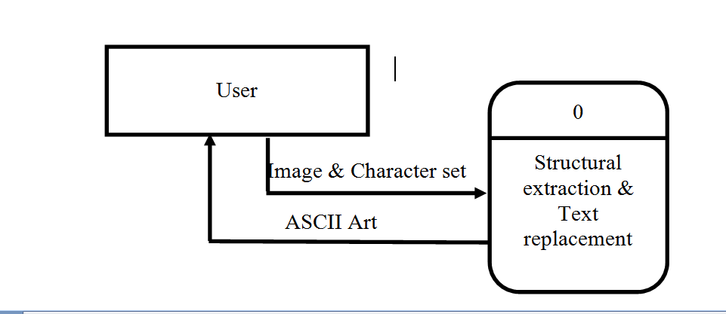
LEVEL 0 DFD
SYSTEM OVERVIEW

Slide 14
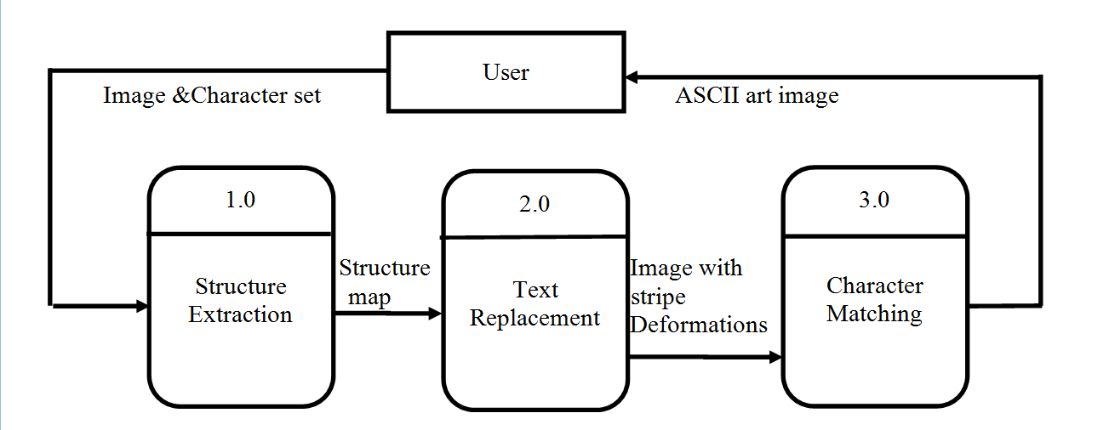
LEVEL 1 DFD

Slide 15
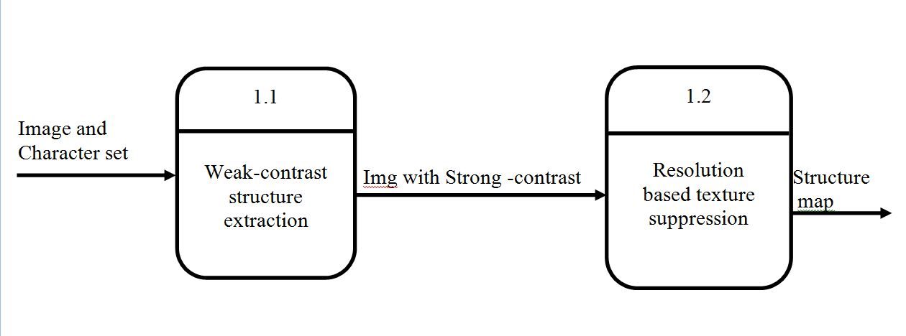
LEVEL 2 DFD

Slide 16
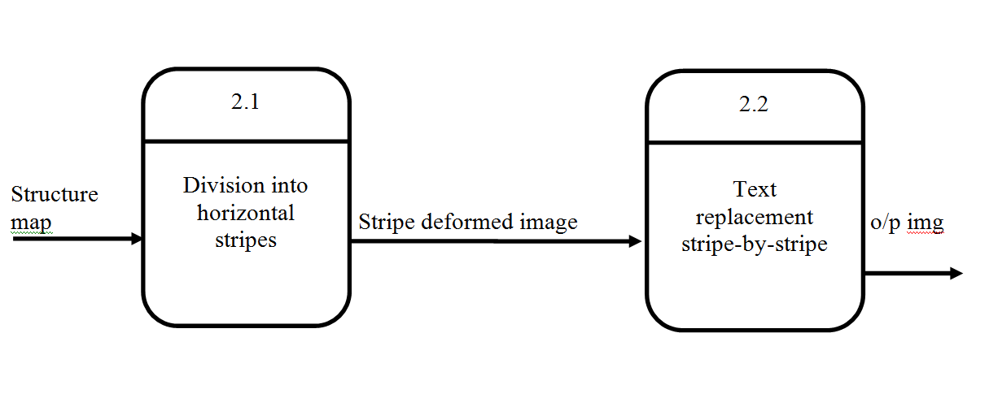
LEVEL 2 DFD

Slide 17
CONCLUSION
The project proposes the implementation of visual perception mechanism
Which can better separate weak structure from the crowded texture
Can also better control the scale of texture suppression

Slide 18
THANK YOU!

